Slide 1

YOUTH CRIME
Year 9 Drama
Lesson 2 – Meeting Marcus

Slide 2
Lesson Objectives:
To develop Marcus’s character through significant action and marking the moment.
To explore why he might have committed a crime.
Notes:
This scheme of work consists of a series of six lessons based on the exploration of youth crime. It is
hoped that through practical exploration, students will gain a greater understanding of youth crime,
the types of crimes that young people commit, and most importantly why.
By the end of this scheme students will understand more about the law and young offenders, and
the reasons behind young offenders committing crimes. Throughout these lessons students will be
developing drama skills such as scriptwriting and forum theatre. The terminology and skills used
are in line with the Edexcel GCSE specification.

Slide 3
Lesson Outcomes:
I will stay in role during tasks/activities/performances.
I will perform a character different to myself during tasks/activities/performances.
I will confidently use drama techniques (significant action/marking the moment ) during my exploration.
I will use P.E.E.E.E.E. when evaluating my own work and the work of my peers.

Slide 4
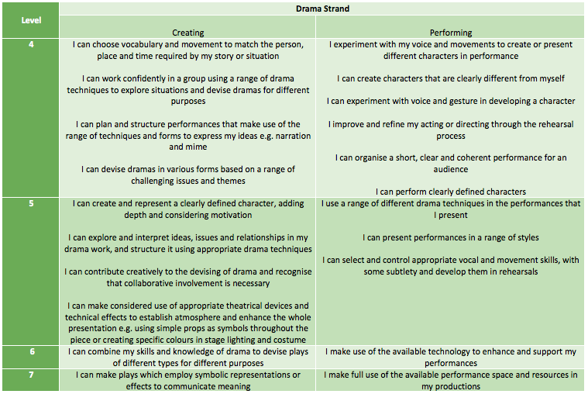
LESSON OUTCOMES

Slide 5
STARTER
3-15 Minutes

Slide 6

YOUTH WORKER
Teacher in role as Youth Worker.
Explains that Marcus is the boy in last week’s poem.
‘It’s my first week in this job and I’ve been assigned to work with this young offender, Marcus, he’s only fifteen. I don’t think anything can really prepare you for what some of these young people have been through and the things they’ve done. I don’t really know if can tell you….’
Notes:
Discuss anger issues and the problems there. Imply that he has assaulted someone on more than one occasion, related to alcohol abuse.

Slide 7
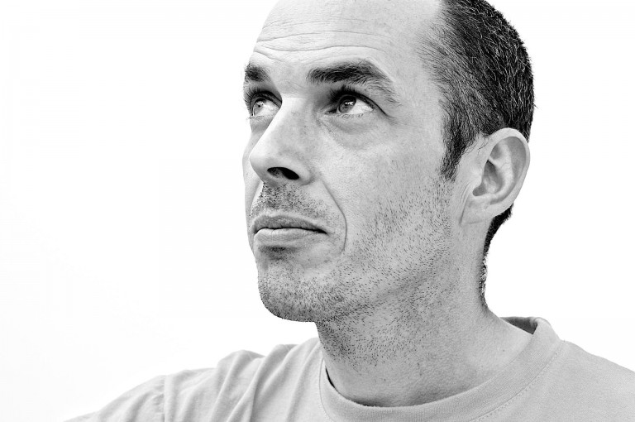
HELP THE YOUTH WORKER
“I’m not sure what to do sometimes…I could do with some help from people his age
Notes:
Teacher in role helps the students to invest in both the character of Marcus and the Youth Worker. By adopting a middle status role and asking for the students’ help, they will be more willing to offer suggestions and contribute. By laying down important facts like his age, the students can relate to the fact that Marcus is a young person, like them. Allow students time to Think/Pair/Share before asking for answers. This discussion will need to be managed well and any inappropriate suggestions dealt with.

Slide 8

WHOLE CLASS DISCUSSION
Out of role discussion
What crime might he have committed?

Slide 9
WARM UP
15-30 Minutes

Slide 10
MARCUS’S ROOM
A bedroom is a very personal place, and it says a lot about a person. What will Marcus’s bedroom say about him?
Think/Pair/Share
Question: What do you think Marcus’s bedroom at home looks like?
Feedback answers as a class.

Slide 11
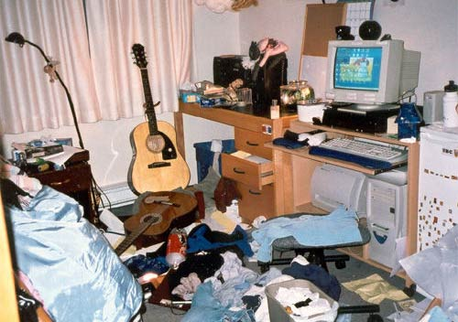
INDIVIDUAL TASK
On your own you are to draw/design/write about what you think Marcus’s room will look like.

Slide 12
I SEE…
As a whole class we are going to create Marcus’s bedroom, before he went into the Young Offender Institution.
Stand in a square to make the walls of the room.
Teacher starts the description: ‘I can see a packet of tobacco and some cigarette papers lying on his bedside table.’
Students add what they can see in the room as you go around the square.

Slide 13
GROUP WORK
30 - 45 Minutes

Slide 14
ITEM PERFORMANCE
In groups of 4–5. Students will pick an item from Marcus’s bedroom that they think tells us something about him, and which has a story behind it.
Discuss in groups which item you want to work with and why it is significant.
Create a short scene using this item that shows why the object is important.
Performances should include:
Significant action
Layers of meaning (ACTION, MOTIVATION, INVESTMENT, MODEL, VALUES)
Notes:
Lower ability groups may find it easier to start by creating a still image and gradually building up to a scene by adding in dialogue and movement.

Slide 15
PERFORM/FEEDBACK
45 - 55 Minutes

Slide 16
PERFORM/FEEDBACK
Some groups will perform
Students are to give peer feedback (using P.E.E.E.E.E) by writing on a post-it note and sticking it on the wall.
Teacher will select some post-its’ to read out.
REMEMBER
Point (E)
Example (D)
Explain (C)
Explore (C/B)
Expand (B/A)
Evaluate (A)
Notes:
A good way of encouraging all students to participate is to ask them to write their response on a post-it and stick it to the board. The teacher can then select some answers from the board to discuss as a whole class.

Slide 17
PLENARY
55 -60 Minutes

Slide 18
QUESTION TIME
THINK PAIR SHARE WITH SOMEONE YOU HAVEN’T WORKED WITH TODAY
Question: What have we learnt about Marcus from exploring these significant objects?
Notes:
Allow students time to Think/Pair/Share before directly asking for an answer. Challenge more able students to elaborate on their answers, giving reasons for them.

Slide 19
HOW DID YOU DO TODAY?

Slide 20
LESSON OUTCOMES ADD LEVELS and DIFFERENTIATION
I will stay in role during tasks/activities/performances.
I will perform a character different to myself during tasks/activities/performances.
I will confidently use drama techniques (thought tracking/still image) during my exploration.
I will use P.E.E.E.E.E. when evaluating my own work and the work of my peers.

